Slide 1
Automated Process-Fluid Flow Skid
Lam Research Challenge 3.0 · Stage 2 Hardware Hustle · Team [Team name]
M
M · Mechanical
Hydraulics and build
E1
E1 · Electrical
Power and wiring
E2
E2 · Electrical
Control and Case 1
E3
E3 · Electrical
Case 2 and results
Notes:
M speaks. Slide 1, 0:00 to 0:20. Full word-for-word speeches are in Stage2_Video_Script.pdf.

Slide 2
Set a flow, measure it, protect it, flush it
M
Case 1
Control and measurement
Circulate process fluid TK-01 → sump → TK-01 with P-01 at 50 % and P-02 at 100 %. Measure and totalise the return flow. If fluid is suddenly dumped into the sump, stop P-01, keep P-02 draining, then resume.
Case 2
Flush and shutdown
Isolate TK-01 with the solenoid, flush from the 4.2 L tank with all three pumps running, then switch everything off with the button once the flush water is gone.
8 mm
pipe diameter (paper)
1–6
L/min required range
3 L/min
nominal target flow
0
hands on valves during the run
Notes:
M speaks. Slide 2, 0:20 to 0:55.

Slide 3
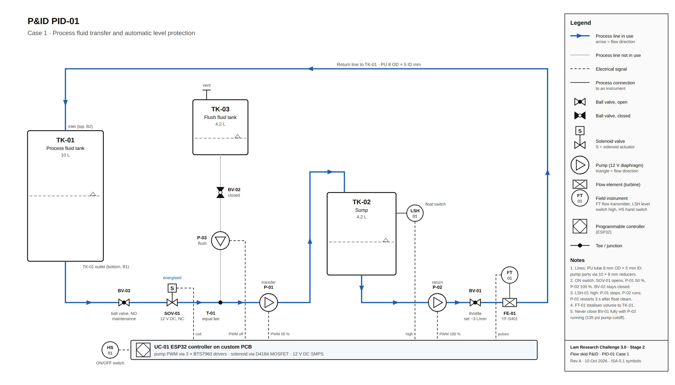
Case 1 P&ID: follow the blue line
M
TK-01 → BV-03 → SOV-01 → T-01 → P-01 → TK-02 sump → P-02 → BV-01 → FT-01 → back to TK-01
Notes:
M speaks. Slide 3, 0:55 to 1:30. Point along the flow path while speaking.

Slide 4
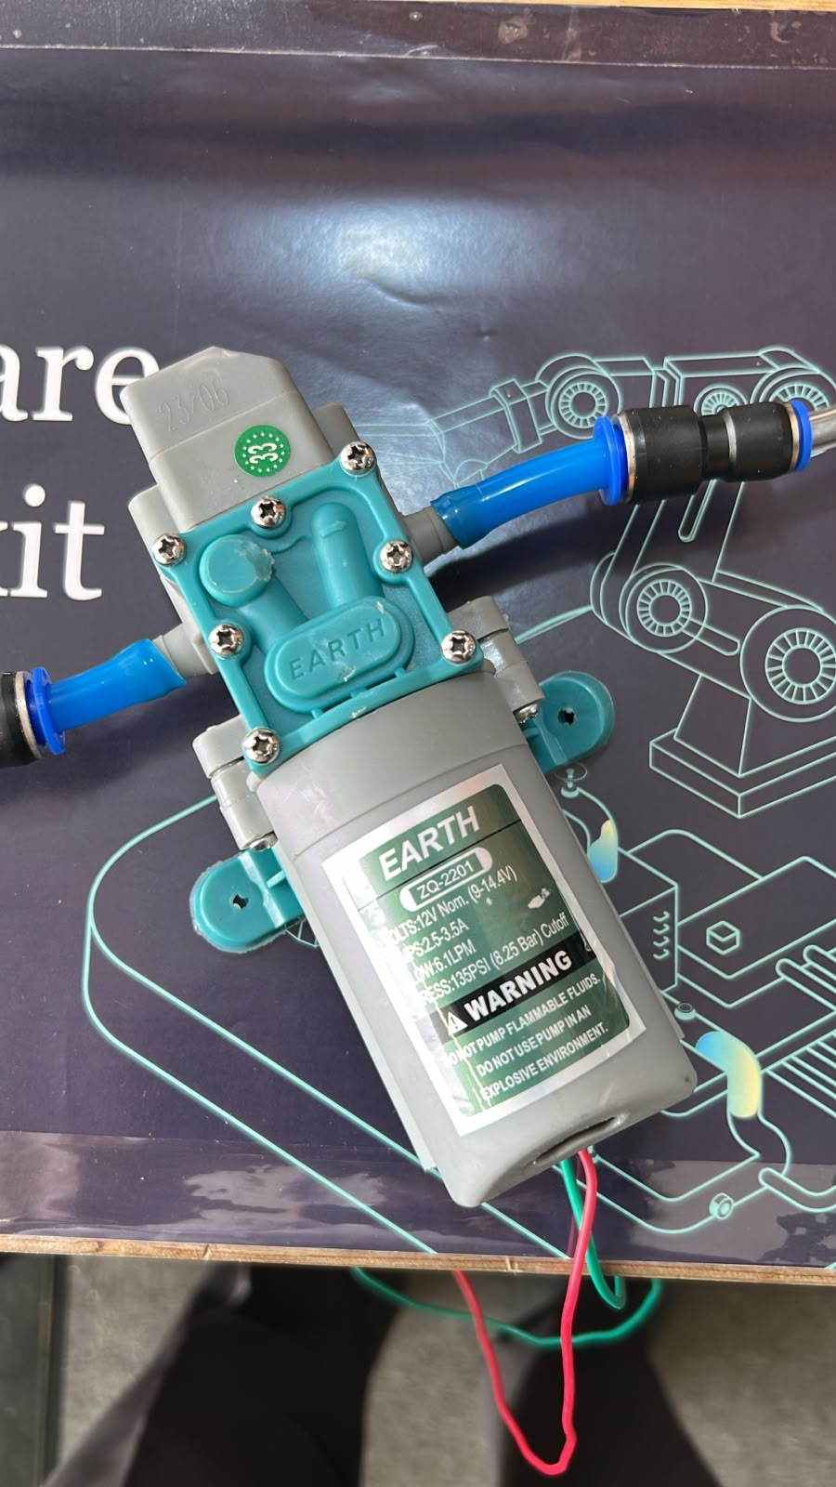
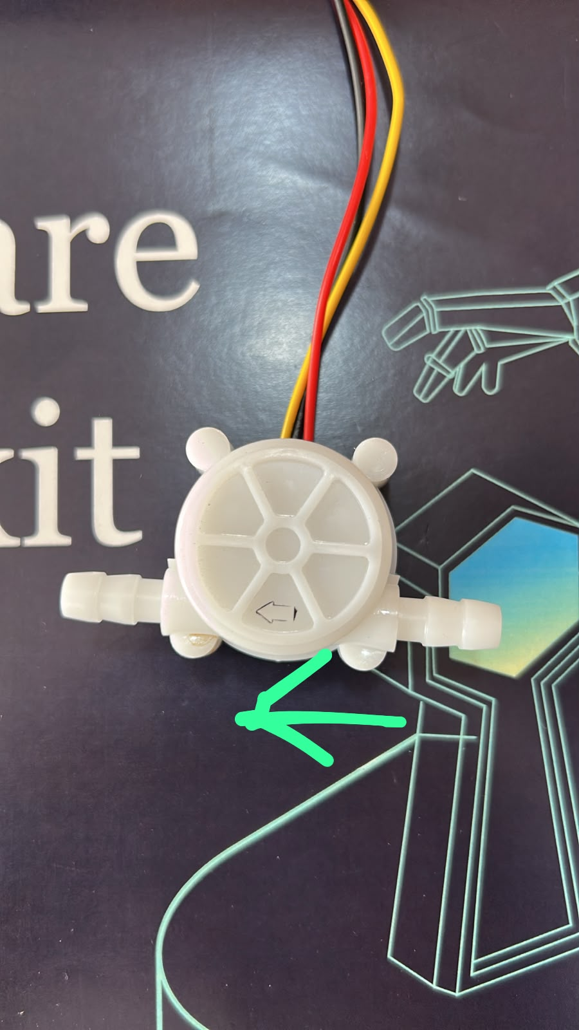
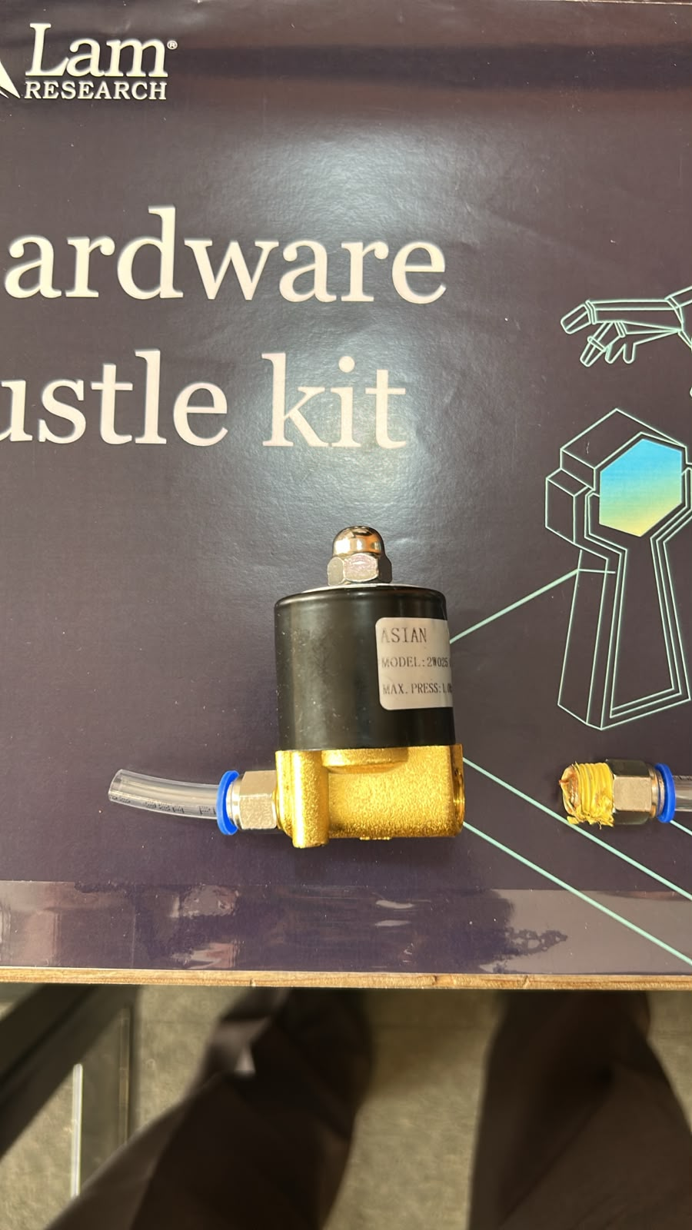
Every component, in flow order
M
Case 1 loop
Flush branch
TK-01
10 L process tank
bottom outlet, top return
TK-03
4.2 L flush tank
bottom outlet, vented top
BV-03
ball valve
maintenance shut-off, open
BV-02
ball valve
left open; idle P-03 holds back
SOV-01
12 V solenoid
isolates TK-01 in Case 2
P-03
flush pump
feeds the tee
T-01
equal tee
flush line joins here
Instruments
P-01
transfer pump
50 % PWM into sump
Pump
FT-01
SOV-01
FT-01
flow transmitter
YF-S401 turbine, pulses
Insert screenshot
Labelled photo of our finished skid
TK-02
4.2 L sump
top inlet, bottom outlet
LSH-01
float switch
sump high level
P-02
return pump
100 % PWM
HS-01
ON/OFF button
starts the sequence
BV-01
ball valve
throttle, sets the flow
Notes:
M speaks. Slide 4, 1:30 to 2:15. Cut to live camera on the rig and point at each tag in this order.

Slide 5
Built for the tube we actually have
M
Paper says 8 mm. The kit tube is 8 mm OD × 5 mm ID.
1
Joints
Brass bulkhead with a washer each side at every tank port; Teflon tape on every thread.
at 3 L/min | 8 mm bore | 5 mm bore
Velocity | 0.99 m/s | 2.55 m/s
Reynolds no. | 7 960 | 12 700
Friction loss | ≈ 2 kPa/m | ≈ 19 kPa/m
2
Pump ports
Short 10 × 8 mm blue tube with reducers only at the pumps; 5 mm PU tube elsewhere.
3
Leak test
Water in, pumps off, then running, before any electronics came near the wet side.
Same flow, 2.56 × faster water and about 9 × the friction. That is why our loop delivers about 2 to 2.5 L/min, not the pump's 6.1 L/min free-flow rating.
4
Safe limits
Never close BV-01 with P-02 running (135 psi cutoff). Start TK-01 at about 5 L so the flush cannot overflow it.
Notes:
M speaks. Slide 5, 2:15 to 3:00. Hand over to E1.

Slide 6
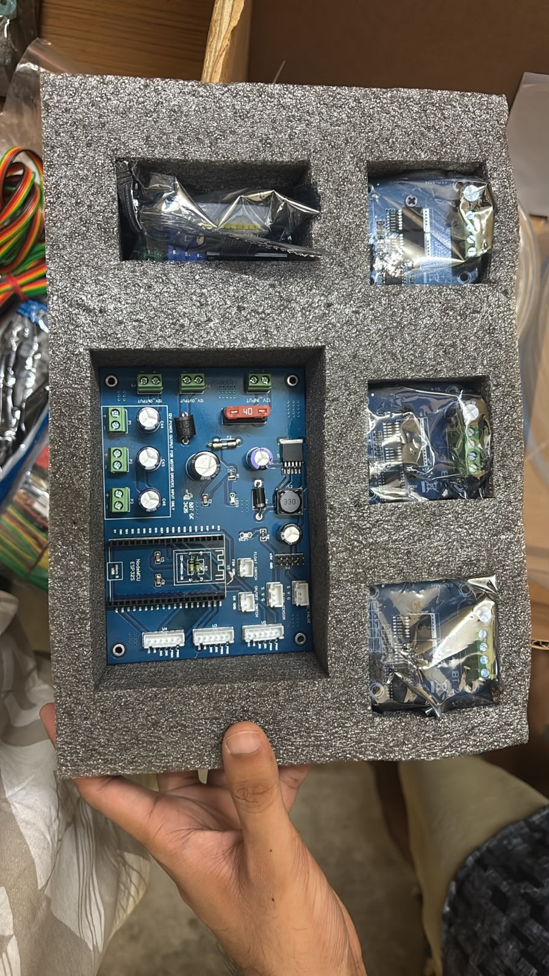
One 12 V supply, one ESP32, three drivers
E1
BTS7960 #1
U2 · P1
P-01
Custom PCB
ESP32 controller
40 A fuse
BTS7960 #2
U3 · P2
P-02
12 V SMPS
LRS-350-12, 29 A
BTS7960 #3
U4 · P3
P-03
D4184 MOSFET
GPIO 27
SOV-01
≈ 11 A
worst case in Case 2: three pumps at up to 3.5 A plus the solenoid
FT-01 pulses
GPIO 14
LSH-01 float
GPIO 35
HS-01 button
GPIO 34
Outputs
PWM + enable to each driver
Notes:
E1 speaks. Slide 6, 3:00 to 3:50.

Slide 7
Three faults, one symptom: nothing moves
E1
P-02 driver dead
FT-01 reads 0
Button ignored
Cause
No R_PWM2 trace on the PCB (organiser notice).
Fix
Drive P-02 from L_PWM2, tie the driver's unused RPWM input high, invert in firmware.
Cause
Zero edges on GPIO 14: red and black swapped on S-V-G, so the Hall chip had reversed supply.
Fix
Red → V, black → G, yellow → S. Then mounted it vertically, flow upward, so it runs full; flat, it under-read.
Cause
Shorting SW to GND worked, the switch did not.
Fix
Wired across diagonal legs of the tact switch.
Notes:
E1 speaks. Slide 7, 3:50 to 4:50. Hand over to E2.

Slide 8
The button steps through every case
E2
IDLE
all off, SOV closed
CASE 1
SOV open, P-01 50 %, P-02 100 %
FLUSH PREP
SOV closed, P-01 paused, 15 s hold
FLUSH
P-01, P-02, P-03 at 100 %
DONE
all off, SOV closed
button
button (or 150 s)
after 15 s
button
1
Float high for 300 ms
P-01 (and P-03 in the flush) stop; P-02 keeps draining the sump.
2
Float clear for 3 s
P-01 restarts. The delay stops a sloshing surface from chattering the pump.
3
0.6 s soft start
Every pump ramps up, so three motors never hit the SMPS at once.
4
Fail-safe
Reset or power loss lands in IDLE with the solenoid closed. Typing stop ends everything from any state.
Notes:
E2 speaks. Slide 8, 4:50 to 5:40.

Slide 9
From pulses to litres
E2
1
2
3
4
5
Pulse
FT-01 rotor turns; each Hall pulse fires an interrupt on GPIO 14
Filter
Edges closer than 300 µs rejected; 6 L/min is only ≈ 590 Hz
Frequency
every 0.5 s: f = N / t
Flow
Q = a·f + b (our calibration)
mL/s = L/min × 1000 / 60
Total
litres returned = Σ Q·Δt
streamed as CSV, plotted live
≈ 98 Hz
per L/min: datasheet start value, replaced by our fit
50 mL/s
equals the 3 L/min target
0.5 s
logging period, one CSV row per sample
Notes:
E2 speaks. Slide 9, 5:40 to 6:15.

Slide 10
Case 1 live: sudden charge into the sump
E2
1
Press ON
SOV-01 clicks open, P-01 50 %, P-02 100 %
Insert screenshot
Flow vs time in mL/s from flow_logger.py, with the sump-charge event marked
2
Steady flow
FT-01 ≈ [__] L/min = [__] mL/s, total climbing
3
Pour ≈ 1 L into sump
LSH-01 trips: P-01 stops, P-02 keeps running
4
Level falls
float clear 3 s, P-01 restarts, loop resumes
[__] L
total returned to TK-01
[__] L/min
steady return flow
Notes:
E2 speaks over live footage. Slide 10, 6:15 to 7:20. Hand over to E3 as Case 1 ends.

Slide 11
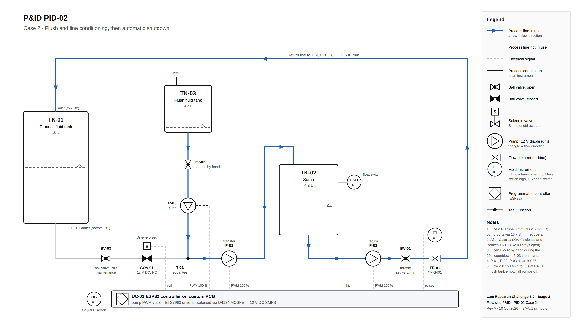
Case 2 live: flush, then stop on the button
E3
Stop
When the flush tank is empty and FT-01 falls toward zero, one press of the button switches every pump off. SOV-01 stays closed.
Protection
The float switch still stops P-01 and P-03 if the sump runs high during the flush.
Check
Flush total [__] L vs 4.2 L put in.
TK-03 → BV-02 → P-03 → T-01 → P-01 → sump → P-02 → FT-01 → TK-01
Notes:
E3 speaks over live footage. Slide 11, 7:20 to 8:40.

Slide 12
We calibrated FT-01 instead of trusting it
E3
Trial | N | t (s) | f (Hz) | V (L) | Q (L/min)
1
2
3
4
5
Q = a·f + b
[__]
a
[__]
b
[__]
R²
[__] %
max err
[__] %
avg err
Five timed bucket trials: f = N/t, Q = V/t, least-squares fit.
Measured: the loop tops out near [2–2.5] L/min, so 6 L/min is out of reach with a 5 mm bore, BV-01 and the FT-01 nozzle.
Notes:
E3 speaks. Slide 12, 8:40 to 9:20.

Slide 13
A ball valve is a coarse throttle
E3
Insert screenshot
Q2.1 graph: BV-01 position (%) vs flow (L/min) at 25, 50, 75, 100 %
1
Quick opening
Most of the flow arrives in the first half of the quarter turn.
2
Flat at the top
Above 75 % the pump, tubing and FT-01 set the flow, not the valve.
3
Our decision
Hold 3 L/min by trimming BV-01 and P-02 PWM, not by valve angle alone.
Notes:
E3 speaks. Slide 13, 9:20 to 9:40.

Slide 14
One button. Measured, protected, flushed.
Case 1 and Case 2 in one run, stepped by the ON/OFF button, with no hand on a valve.
M
E1
E2
E3
Thank you
Notes:
E3 speaks. Slide 14, 9:40 to 10:00.

